Slide 1
Proximity Sensor
A proximity sensor is a component which is designed to detect the absence or presence of an object without the need for physical contact. They are non-contact devices, highly useful for working with delicate or unstable objects which could be damaged by contact with other types of sensor.
This non-contact operation also means that most types of proximity sensor (excluding types such as magnetic proximity sensors) have a prolonged lifespan. This is because they have semiconductor outputs, meaning that no contacts are used for output.
Proximity sensors are designed to provide a high-speed response (the interval between the point when the object triggers the sensor and the point when the output activates). Different types use varying sensing technologies but they all have the same purpose.

Slide 2
Proximity Switches
Proximity switch is a term often used interchangeably with proximity sensor, but the two should not be confused. As explained above, a proximity sensor is a non-contact component which detects the presence of objects within its sensing range. On the other hand, a proximity switch is a specific component which opens or closes the electrical circuit when the sensor detects the absence or presence of an object.

Slide 3
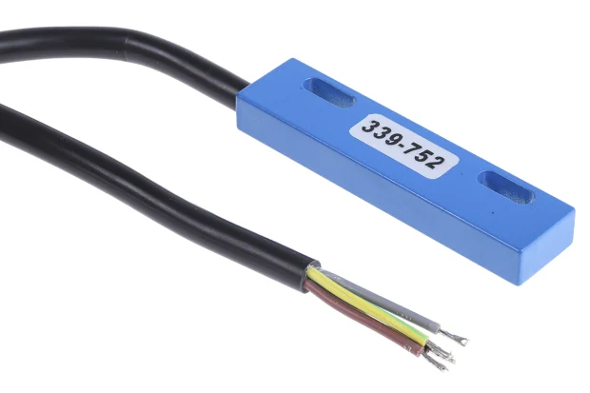
How Do Proximity Sensors Work?
In the simplest terms, proximity sensors work by transmitting data about the presence or motion of an object into an electrical signal. They output an ON signal when the object enters their range.

Slide 4
Types of proximity sensors
Capacitive Proximity Sensor Working Principle
Capacitive proximity sensors work by detecting changes in capacitance between the sensor and an object. Factors such as distance and the size of the object will affect the amount of capacitance. The sensor simply detects any changes in capacity generated between the two.

Slide 5
Types of proximity sensors Cont’d..
Inductive Proximity Sensor Working Principle
Inductive sensors work by detecting eddy currents causing magnetic loss, generated by external magnetic fields on a conductive surface. The detection coil generates an AC magnetic field, and impedance changes are detected as a result of generated eddy currents.

Slide 6
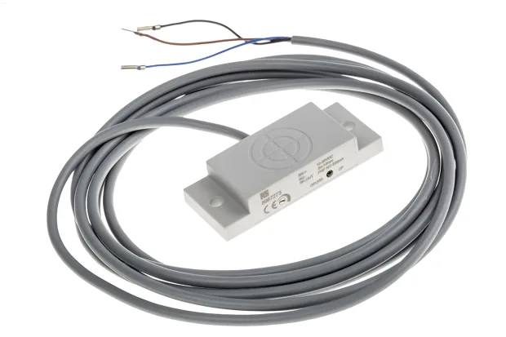
Applications of proximity sensors
Standard object position detection
Transportation, logistics, and supply chain
Inspection and quality assurance
Process control
Level detection
Food processing and manufacturing
Agriculture

